Slide 1
GenAI HW6
Learning from Human Preference
TA: 白鈺綺 呂瑋杰 余奇恩
ntu-gen-ai-2024-spring-ta@googlegroups.com
Deadline: 2024/05/02 23:59:59 (UTC+8)
Notes:
讓模型輸出人類偏好的回答
Learning from Human Preference 从人类偏好中学习

Slide 2
Outline
Link
Colab
DaVinci
Report Grader
Task Overview
TODOs
Submission and Grading
Appendix
Execution Sample Code at Colab
Grading Report Answer by DaVinci
Check Report Score by Report Grader (optional)
Notes:
作業內容跟主題

Slide 3
Task Overview

Slide 4
LLM Values Alignment (Learning Human Preferences)
Values Alignment: Align the value of LLMs to the desired value of humans
Precisely, we want the LLM to prefer 動漫真人化
LLM
before alignment
我只是個AI模型，不具個人意見……
同不同意漫畫真人化?
Alignment training
LLM
after alignment
同不同意漫畫真人化?
我同意漫畫真人化，因為…
values alignment
Notes:
LLM Values Alignment (Learning Human Preferences) LLM 价值观对齐（学习人类偏好）
Values Alignment: Align the value of LLMs to the desired value of humans 价值观对齐：将 LLM 的价值观与人类期望的价值对齐
Precisely, we want the LLM to prefer 動漫真人化 确切地说，我们希望 LLM 偏爱 漫真人化

Slide 5
Goal of This Homework
You will learn how to align LLMs to a specific value
The standard way of alignment training is RLHF (Reinforcement Learning with Human Feedback)

Slide 6
Supervised Learning vs. RLHF
In supervised learning, it's essential to have prepared "standard answers" to train the model.
However, in real-life scenarios, many open questions lack standard answers, requiring us to adopt a preference-based approach.
Thus, we need Reinforcement Learning with Human Feedback (RLHF) to align values of our models.
Supervised Fine-Tuning
Input: 地球到太陽的距離?
Answer: 約1.496億公里
RLHF
Input: 在公車上讓座給有需要的人?
Answer: ???
Notes:
In supervised learning, it's essential to have prepared "standard answers" to train the model. 在监督学习中，准备好“标准答案”来训练模型是必不可少的。
However, in real-life scenarios, many open questions lack standard answers, requiring us to adopt a preference-based approach. 然而，在现实生活中，许多开放性问题缺乏标准答案，需要我们采用基于偏好的方法。
Thus, we need Reinforcement Learning with Human Feedback (RLHF) to align values of our models. 因此，我们需要带有人工反馈的强化学习（RLHF）来调整我们模型的价值观。

Slide 7
Reinforcement Learning from Human Feedback (RLHF)
Standard steps in to RLHF (briefly explain) :
Train a reward model
Fine-tuning LLM with RL

Slide 8
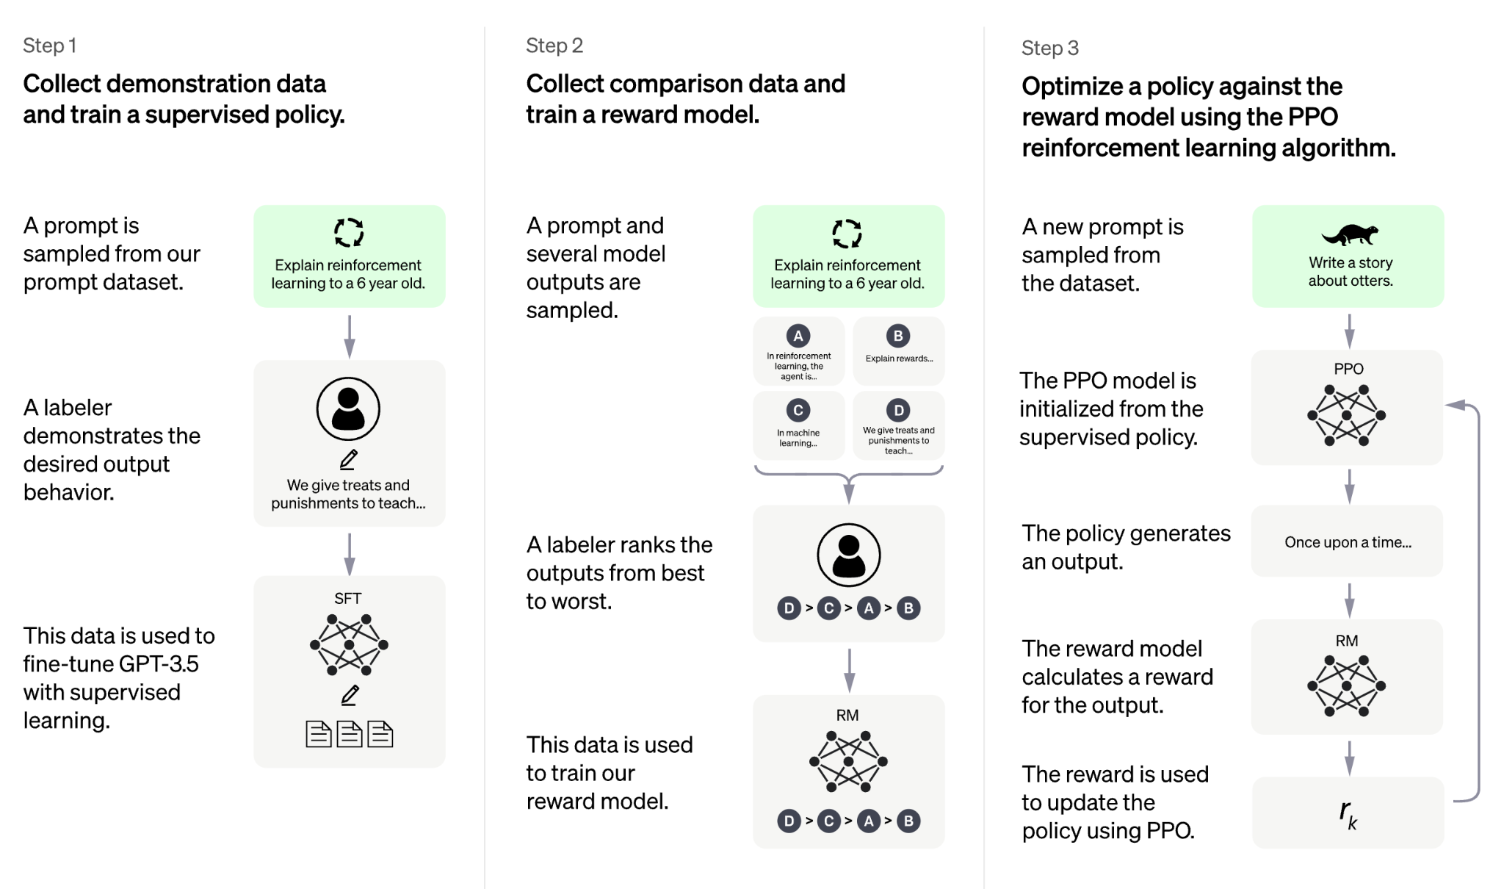
Reinforcement Learning from Human Feedback (RLHF)
Step 1: Reward model training
Collect comparison data
Given a question, there will be multiple responses and humans rank the responses
The reward model learns which responses is better(more similar to human preference)
What is the function of Reward model ?
Evaluate the answer output by LLM
figure ref.

Slide 9
Reinforcement Learning from Human Feedback (RLHF)
Step 2: Fine-tune the LLM using RL with the reward model trained in the previous step
figure ref.

Slide 10
Drawbacks of Standard RLHF
Need to train an additional reward model
RL training is very unstable and hard to tune the hyperparameters
In this homework, we use a simplified method, direct preference optimization (DPO), to align the LLM

Slide 11

DPO - Direct Preference Optimization
Directly provide two different responses, one is the preferred and the other is the not preferred response
The LLM directly learns the preference from the responses without an explicit reward model
undesired answer
Original
LLM
An open question
👍
The preferred response
many open questions
…
The non-preferred response
👎
trained
LLM
An open question
A decisive answer with a clear stance
reference

Slide 12
DPO - Direct Preference Optimization
The LLM is trained to increase the probability of the preferred response and decrease the probability of the not preferred response
Original
LLM
An open question
👍
Prob↑
The preferred response
many open questions
…
The non-preferred response
Prob↓
👎
trained
LLM
An open question
A decisive answer with a clear stance
reference

Slide 13
Homework - LLM Values Alignment

Slide 14
LLM Values Alignment
LLM
before alignment
我只是個AI模型，不具個人意見……
同不同意漫畫真人化?
Alignment training
LLM
after alignment
同不同意漫畫真人化?
我同意漫畫真人化，因為…
values alignment

Slide 15
Task Descriptions
Task: Change the Position of LLM by DPO training method
The original model was neutral, please use DPO to make LLM’s output response aligns with a specific stance desired by humans.
Align Topic: Do you agree or disagree with the adaptation of comics into live-action?

Slide 16
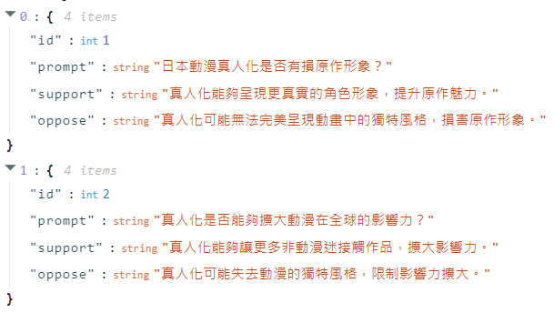
Training Data: Pairwise Preference Data
training set: labelled_data.json, 50 data
prompt: input question
support: answer with supporting position
oppose: answer with opposing position

Slide 17
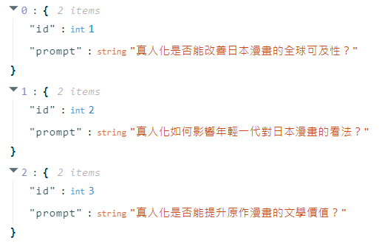
Testing Data
testing set: test_prompt.json, 10 data

Slide 18
Model and Dataset
Dataset : generated by ChatGPT Website
Model : Breeze-7b (聯發科)

Slide 19
What You Will Learn in This Task
How to make the responses of your model more aligned to your preferences.
Have some insight of the effect of
different number of data
training epoch
the quality of data
Notes:
學習讓模型輸出符合自己立場的回答

Slide 20
TODOs

Slide 21



TODO Workflow
1. Run sample code at Colab
2. Grading Report
3. Submit 2 files to NTU COOL
Use Davinci Platform (GenAI hw6 Assistant)
to grade your report answer
Adjust Training Hyperarameters
Answer Report Questions
Observe Model Output

Slide 22
TODO
Run sample code and try some different hyperparameters
Give preference to training dataset
Use DPO and the preference data to train model
Inference testing data and check the position of output
Write your observations of LLM’s response trending into your report
Grade your report by DaVinci Grading Assistant
Submit 2 files to NTU COOL

Slide 23
TODO Workflow
1. Run sample code at Colab
2. Grading Report
3. Submit 2 files to NTU COOL
Use Davinci Platform (GenAI hw6 Assistant)
to grade your report answer
Adjust Training Hyperparameters
Answer Report Questions
Observe Model Output

Slide 24
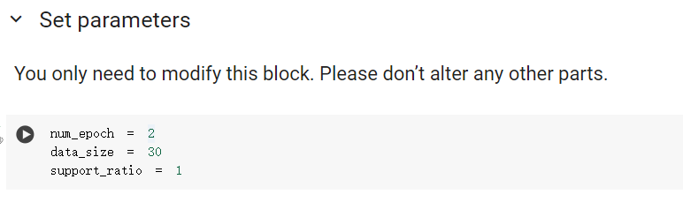
Adjust Training Hyperparameters
support_ratio
data_size
num_epoch

Slide 25
Adjust Training Hyperparameters
support_ratio (支持真人化的資料比例): choose 0.0~1.0 to decide the percentage of training data that supports live action.

Slide 26
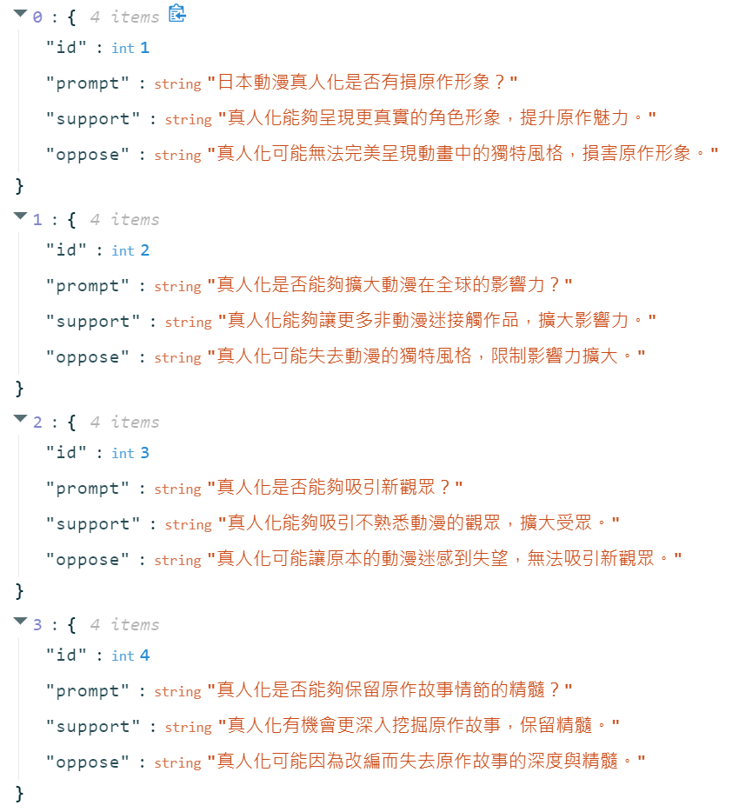
👍
Human preferred response
👍
Support_ratio Example
e.g. for 4 data, support_ratio=0.5
→ 4*0.5 = 2 data for 支持動漫真人化
4 - 2 = 2 data for 反對動漫真人化
👍
👍
Human preferred response

Slide 27
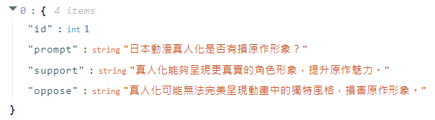
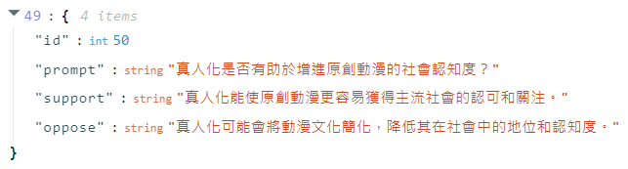
Adjust Training Hyperparameters
data_size: decide the number of training data from 10~50
training set: labelled_data.json
……...
Notes:
用多少筆data去training我們的模型
Give preference to training dataset
Use DPO trainer to finetune model

Slide 28
Adjust Training Hyperparameters
num_epoch: choose 1~3 to select the number of training epoch
: full training dataset
for num_epoch=3:
training
timeline

Slide 29
TODO Workflow
1. Run sample code at Colab
2. Grading Report
3. Submit 2 files to NTU COOL
Use Davinci Platform (GenAI hw6 Assistant)
to grade your report answer
Adjust Training Hyperparameters
Answer Report Questions
Observe Model Output

Slide 30
Colab DEMO

Slide 31
TODO Workflow
1. Run sample code at Colab
2. Grading Report
3. Submit 2 files to NTU COOL
Use Davinci Platform (GenAI hw6 Assistant)
to grade your report answer
Adjust Training Hyperparameters
Answer Report Questions
Observe Model Output

Slide 32
Report Questions
(3%) 在固定50筆data，訓練3個epoch的情況下，觀察調整support_ratio(0-1)對模型inference輸出內容的影響
num_epoch = 3 data_size = 50 support_ratio = 0
num_epoch = 3 data_size = 50 support_ratio = 1
(3%) 在固定50筆data，贊成比例為1的情況下，調整num_epoch(1~3)，觀察控制epoch對模型inference輸出內容的影響
num_epoch = 1 data_size = 50 support_ratio = 1
num_epoch = 3 data_size = 50 support_ratio = 1
(3%) 在訓練3個epoch，贊成比例1為的情況下，調整data_size(10-50) ，觀察data數量對模型inference輸出內容的影響
num_epoch = 3 data_size = 10 support_ratio = 1
num_epoch = 3 data_size = 50 support_ratio = 1
Notes
To answer three report questions, you have to train the model 4 times, each time at least 10 min.
The sections highlighted in blue represent repeated experiments, which do not need to be rerun.
please setting your num_epoch/data_size/support_ratio in the specific range in each question
e.g. num_epoch: 1~3 data_size: 10~50 support_ratio: 0~1

Slide 33
TODO Workflow
1. Run sample code at Colab
2. Grading Report
3. Submit 2 files to NTU COOL
Use Davinci Platform (GenAI hw6 Assistant)
to grade your report answer
Adjust Training hyperparameters
Answer Report Questions
Observe Model Output

Slide 34
DaVinci DEMO

Slide 35
Submission and Grading

Slide 36
TODO Workflow
2. Grading Report
3. Submit 2 files to NTU COOL
1. Run sample code at Colab
Use Davinci Platform (GenAI hw6 Assistant)
to grade your report answer
Adjust Training Hyperparameters
Answer Report Questions
Observe Model Output

Slide 37
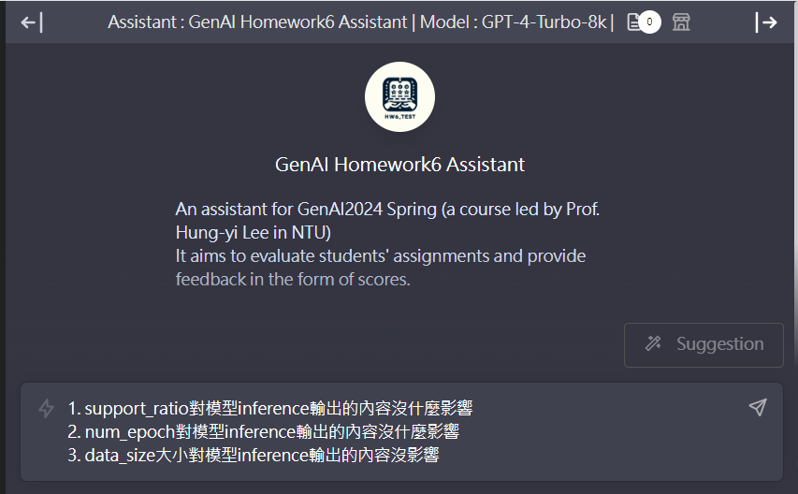
Submission
1. (9%) answer 3 Report Questions and submit conversation record json file
downloaded from DaVinci
⚠️ We will only parse the first response in the conversation for grading.
input your report answer for each report question here, then press Enter

Slide 38
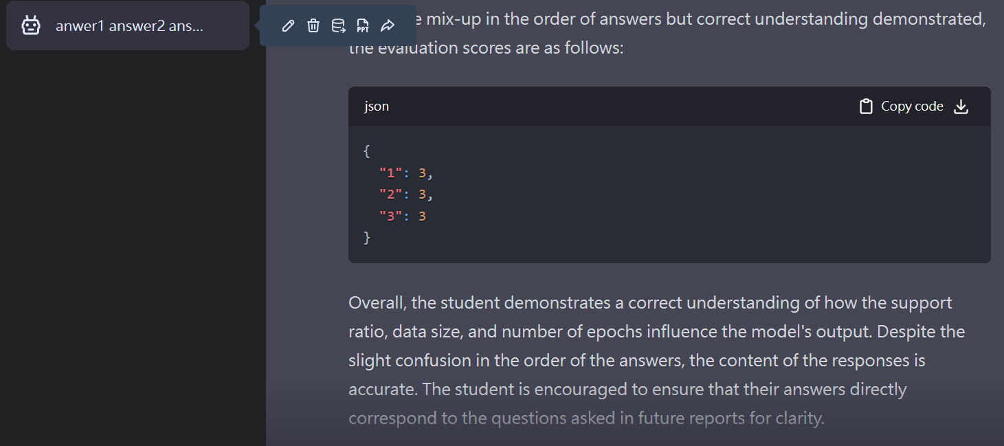
Submission
1. (9%) answer 3 Report Questions and submit conversation record json file
downloaded from DaVinci
⚠️ We will only parse the first response in the conversation for grading.
click
DO NOT download file from there!

Slide 39
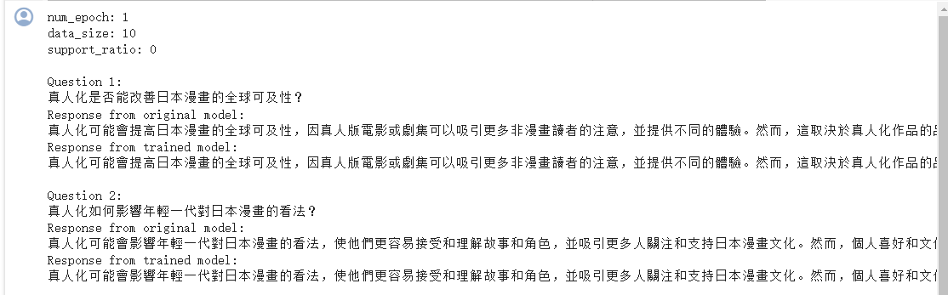
Submission
2. (1%) take 1 screenshot of LLM output on testing dataset at Colab, save it into 1 pdf file
(只需要截其中一次模型訓練完後在測試資料集上的輸出的圖即可)
testing result from Colab

Slide 40
Submission & Deadline
Submit your homework to NTU Cool
Submission format
screenshot file: <student_id>.pdf
ex: b09901000.pdf
report json file(conversation record) from DaVinci: <student_id>.json
ex: b09901000.json
Deadline: 2024/05/02 23:59:59 (UTC+8)
No late submission is allowed
如果作業繳交死線前48小時內達哥因為系統更新或其他因素導致無法使用超過2小時，作業死線會延後至少一天，延後時間將另行公佈，請大家不用緊張

Slide 41
Grading Policy - Judging setting
Model: GPT-4-Turbo-8k from DaVinci
Temperature : precise
⚠️ We will only parse the first response in the conversation json file for grading.

Slide 42
Grading Rules
Plagiarism in any form is prohibited.
Do NOT share your report answers & evaluation results (JSON files) with others.
Do NOT submit the JSON files that are not obtained using your Davinci account.
Do NOT attempt to manually edit your JSON file’s content.
DO NOT change any setting of the grading assistant (the prompts or temperature).
第一次違反以上規定，該作業0分，學期總成績再乘以0.9
第二次違反以上規定，學期成績F
If you submit wrong JSON file, you will get 0 point in report.
Format error or Filename error will results in 0 point. (ex: submitting .png instead of .pdf)
Prof. Lee & the TAs preserve the rights to change the rules & grades.

Slide 43
Grading Release Date
The grading of the homework will be released by 2024/05/10 23:59:59 (UTC+8)

Slide 44
If You Have Any Questions
NTU Cool HW6 作業討論區
如果同學的問題不涉及作業答案或隱私，請一律使用NTU Cool 討論區
助教們會優先回答NTU Cool討論區上的問題
Email: ntu-gen-ai-2024-spring-ta@googlegroups.com
Title should start with [GenAI 2024 Spring Hw6]
Email with the wrong title will be moved to trash automatically
TA Hours
Time:
4/12 Friday (16:30~17:20)
4/19 Friday (14:20~16:20)
Location: 綜合大講堂

Slide 45
Appendix

Slide 46
Execution Sample Code at Colab

Slide 47
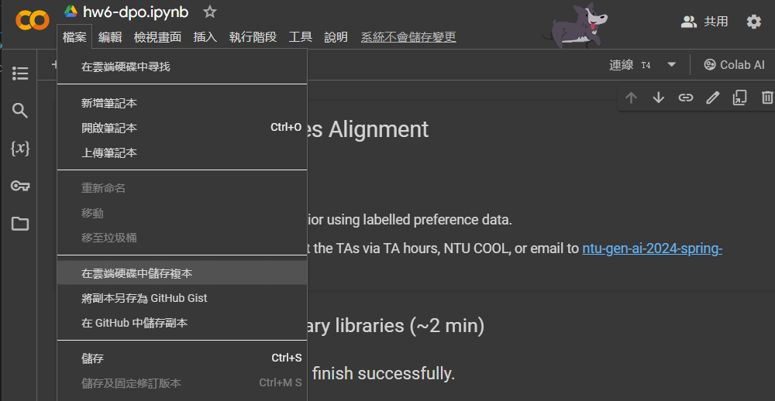
Copy Sample Code to your Gogle Drive
click

Slide 48
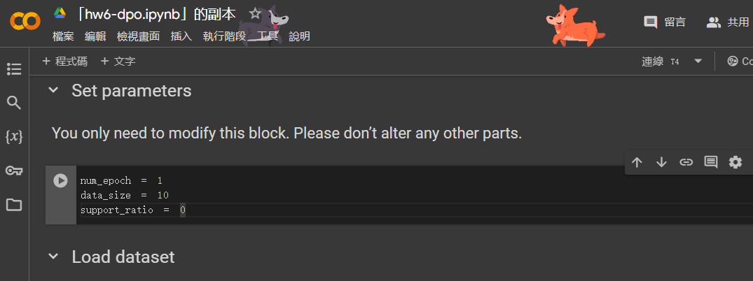
Setting Training Hyperparameters

Slide 49
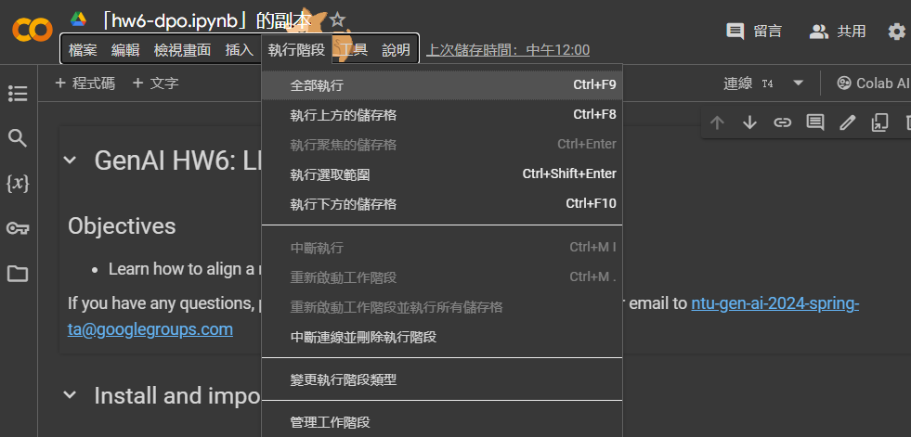
Run Sample Code
click

Slide 50
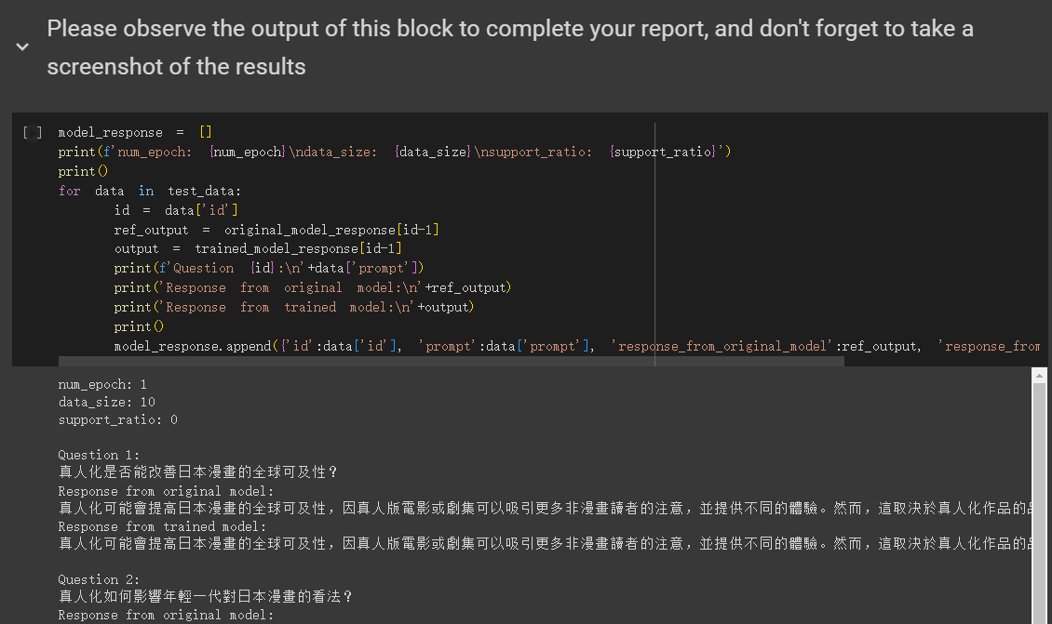
Save LLM testing result
training
hyperparameters
testing
result

Slide 51
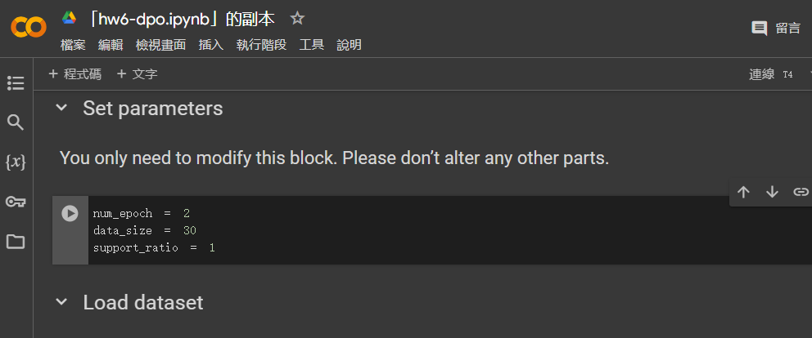
Setting Training hyperparameters Again

Slide 52
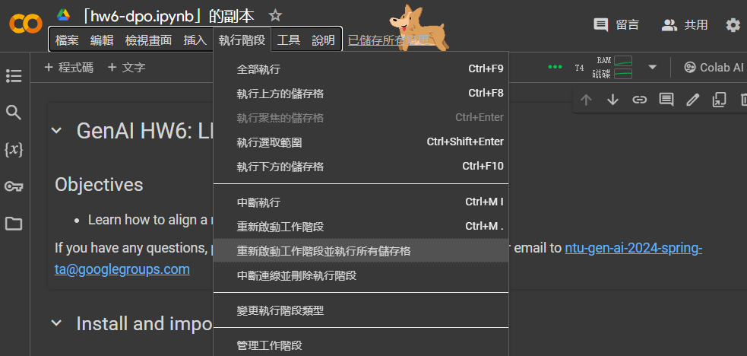
Run Sample Code Again
click

Slide 53
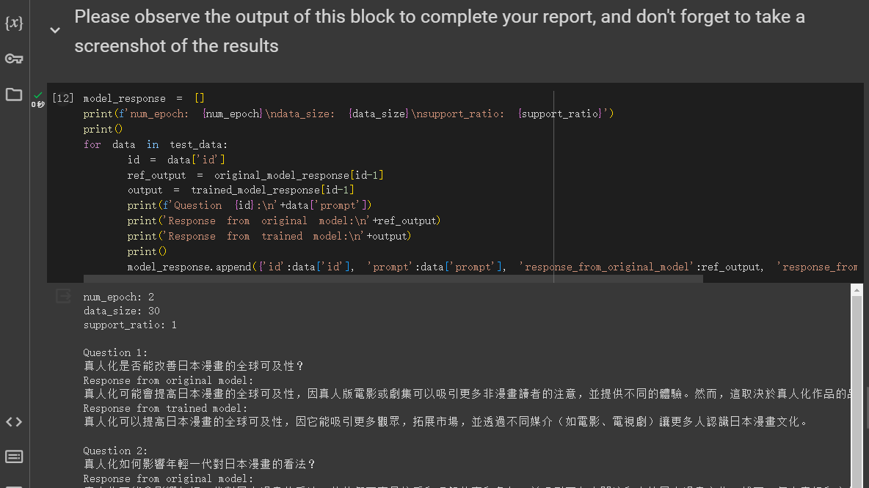
Save LLM testing result Again
training
hyperarameters
testing
result

Slide 54
Grading Report Answer by DaVinci

Slide 55
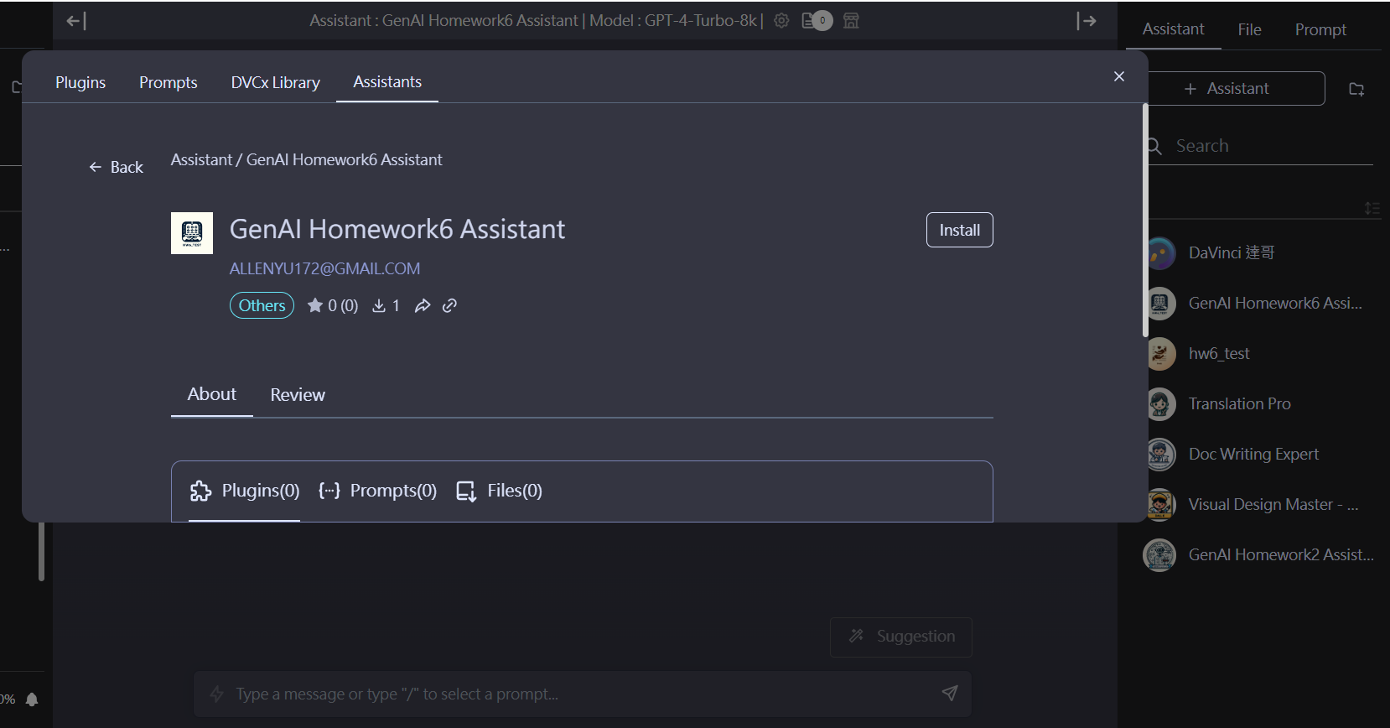
click

Slide 56
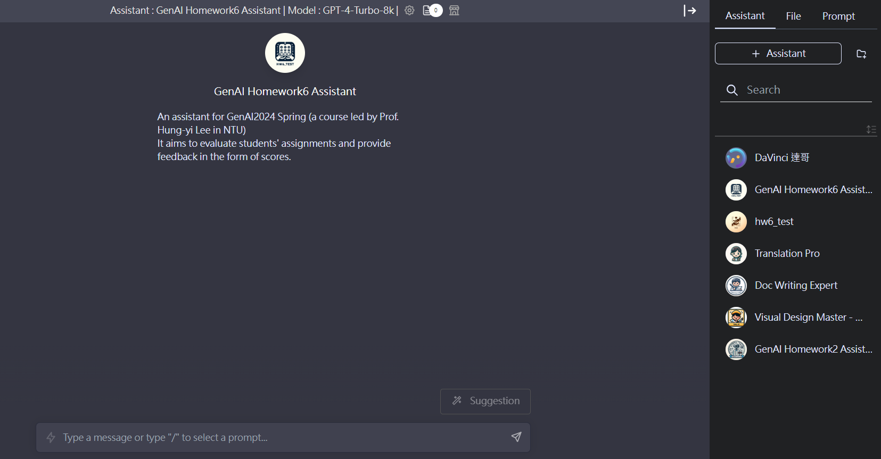
click

Slide 57
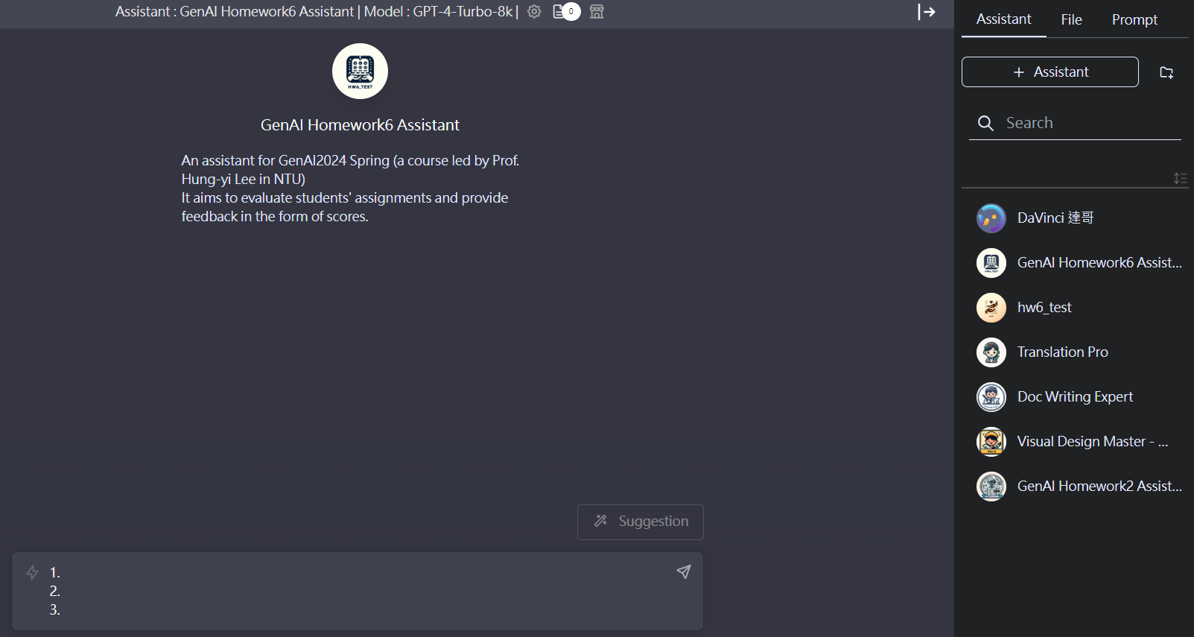
input your report answer for each report question here, then press Enter

Slide 58
For example
input your report answer for each report question here, then press Enter

Slide 59
Check your Score
DO NOT download json file from there!
report score
of each question

Slide 60
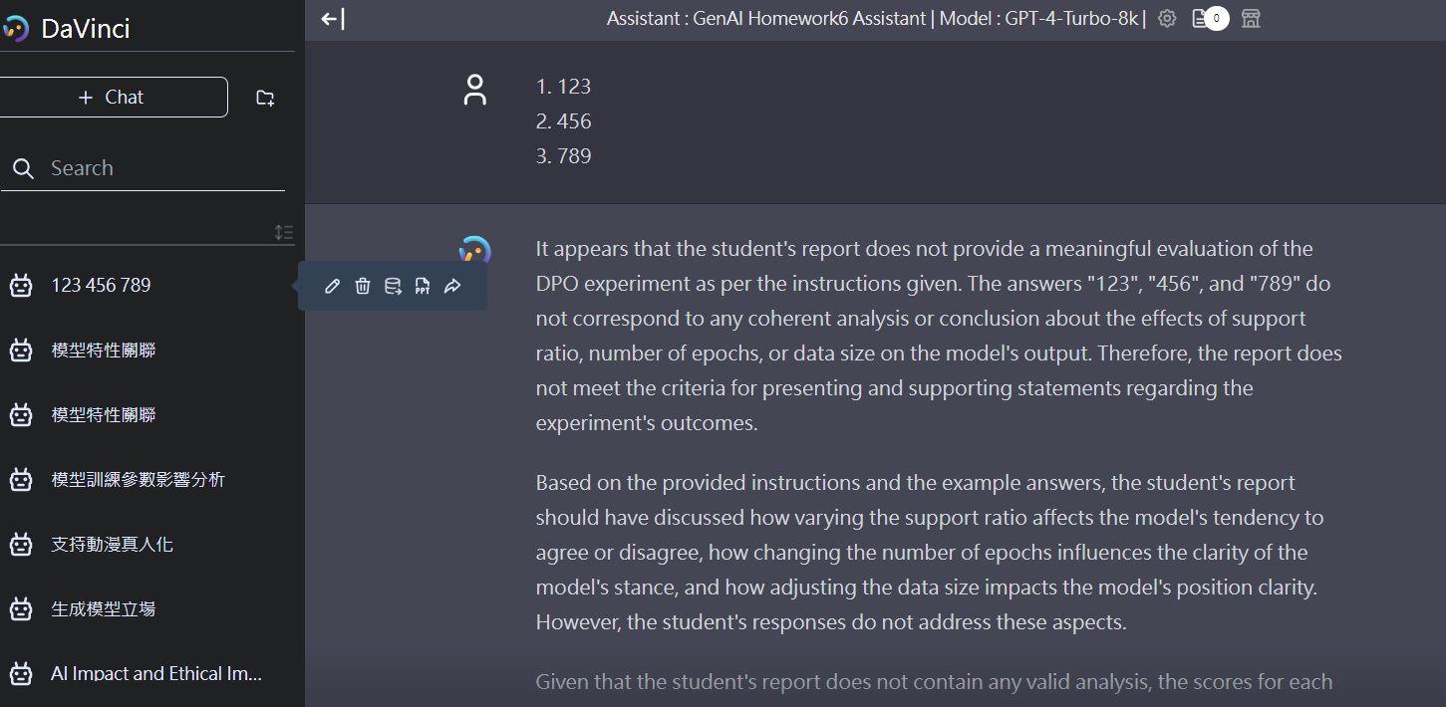
Download Report Grading JSON
click

Slide 61
Check Report Score by Report Grader

Slide 62
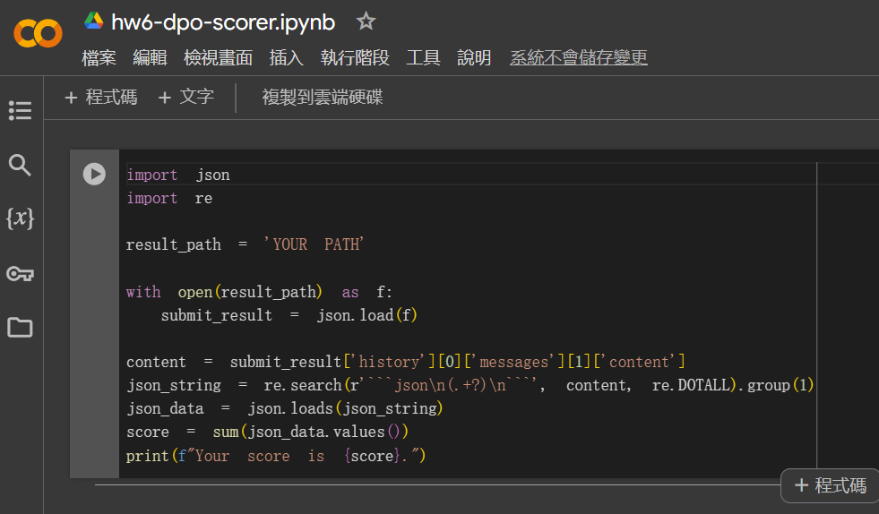
After open Report Grader
click

Slide 63
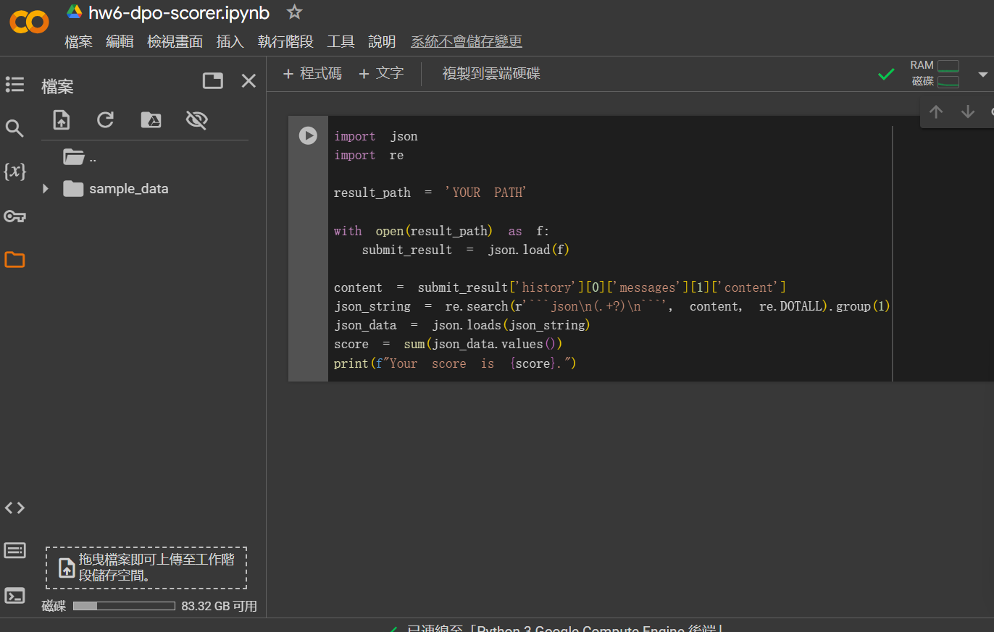
Upload your json file by clicking upload icon
click

Slide 64
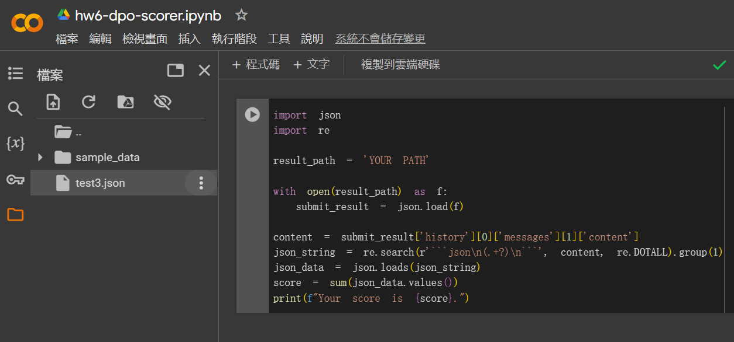
Get your json file path
click

Slide 65
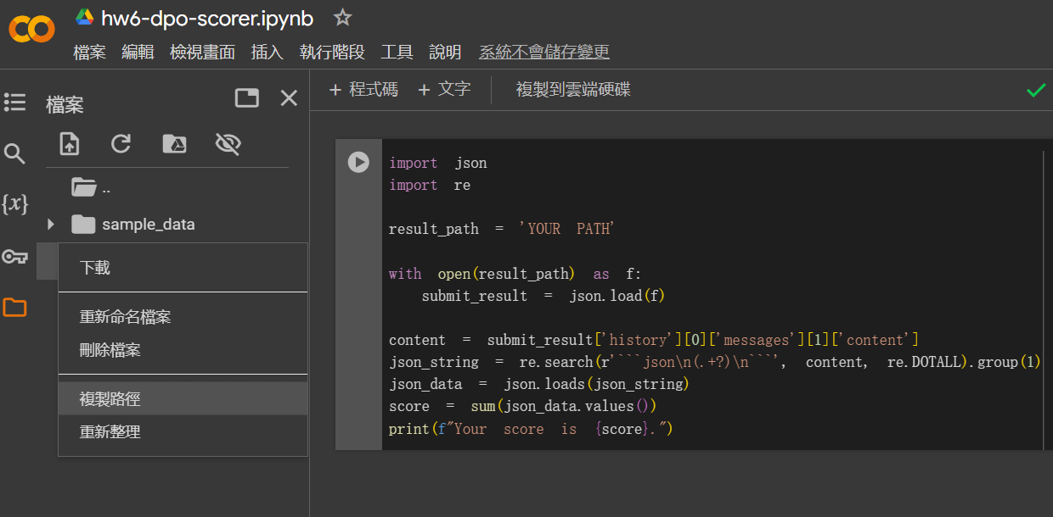
Get your json file path
click

Slide 66
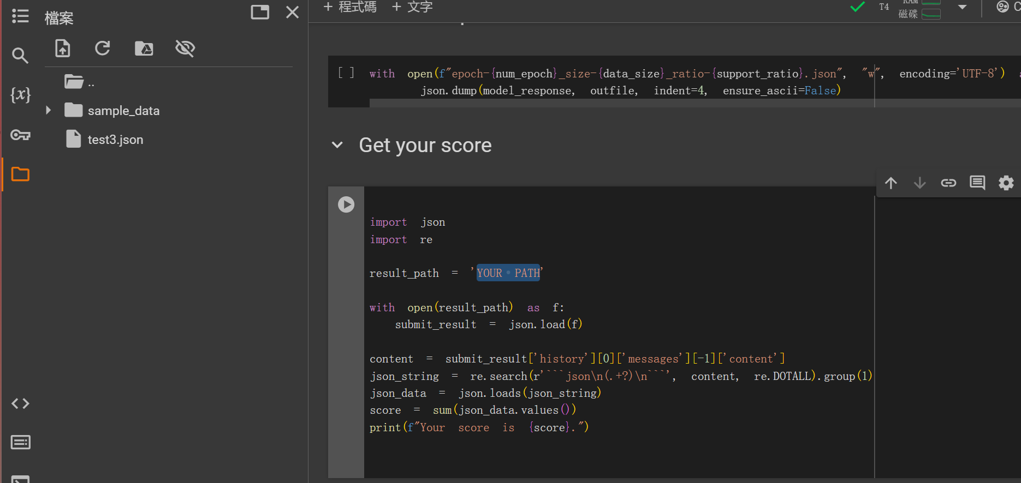
Modify YOUR PATH to your json file’s path
Ctrl + v to paste your json file path in the quote mark

Slide 67
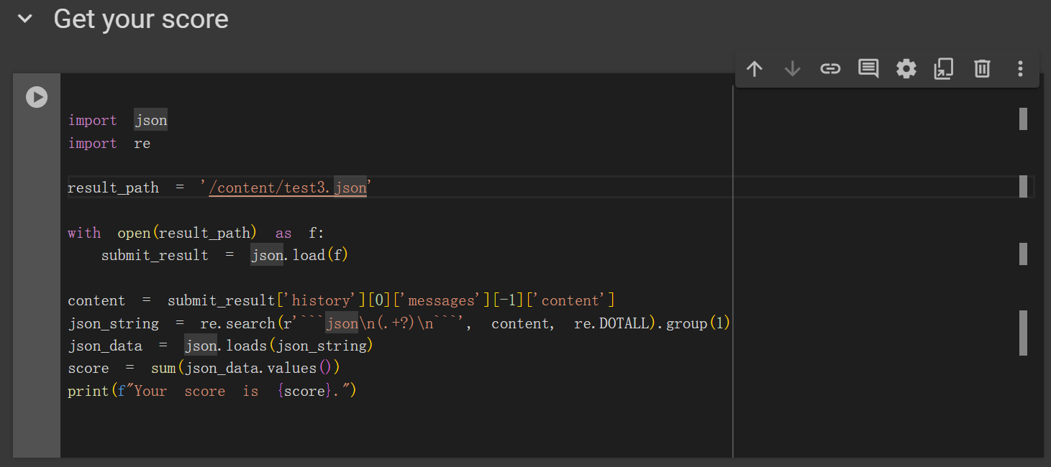
Run the following block
click

Slide 68
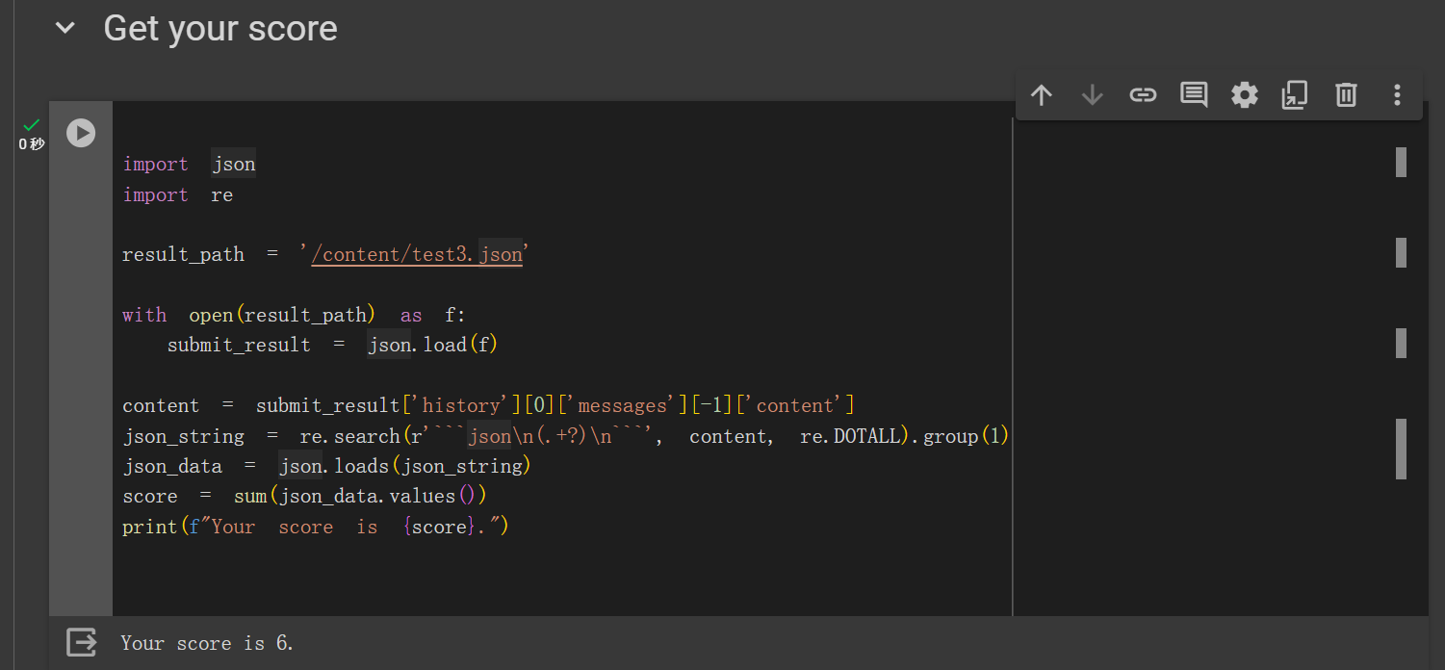
Check your total score of all report questions

Slide 69
Reference
Huggingface introduction to RLHF: https://huggingface.co/blog/rlhf
https://huggingface.co/blog/trl-peft
Direct Preference Optimization(DPO): https://arxiv.org/abs/2305.18290
Evaluation Prompt

